Slide 1
SRI PARAMAKALYANI COLLEGE ALWARKURICHI Department of Computer Science
PRESENTED BY:
J. Rahul – 20191231506225
P. Ramganesh – 20191231506226
GUIDED BY:
Mr. P. NITHIN ,B.Tech.,M.E

Slide 2


Slide 3
ABSTRACT
In the current scenario, there is a race in each and every professional job. It is also true for job market. A job portal is a website dedicated for online information about recruiters as well as job seekers. A job portal helps both the job seekers and recruiters finding the right organization for the employees. In the case of job seekers, according to their educational qualification, experience and their preferences, the job portal shows the list of companies to the job seeker. And, to the recruiters, provides the suitable candidates from a pool of lacks. The objective of this application is to develop a system to enable interaction between employers and applicants. The determination is to allow communication between the interested parties and complete the task of recruitment quickly. To fulfill the job needs of the students they can apply through our job portal.

Slide 4
HARDWARE REQUIREMENTS
Processor: Intel Dual core or above
Speed: 2.0 GHZ or above
RAM: 4Gb or above
Hard Disk: 500GB

Slide 5
SOFTWARE Requirements
Database Used: MYSQL
Language Used: PHP
Design Interface: HTML, Bootstrap, JS Ajax
Browser: Chrome, Microsoft Edge
Software: WAMP/ XAMMP

Slide 6
EXISTING SYSTEM
The existing system for job recruitment includes traditional methods like Employment agencies, advertising through newspapers, televisions and radios, college fairs etc., which are too slow and stressful. With the advancement of internet, jobseekers rely on the online job portals, which makes the job search efficient
As all the work is done manually, there were a lot of work load on placement officer and it also increases the maximum chances of errors
This big problem is the searching; sorting and updating of the student data and no any notification method available for giving information to student except the notice board.

Slide 7
PROPOSED SYSTEM
Applicants can browse through the vacancy details that are posted and can apply for the jobs online.
Employers can browse through the posted resumes and select suitable candidates. Filter, Search facility for job seekers according to their required vacancy.
Daily updates via notifications and other communication media. Sending resume saves effort, time and cost of job seeker .
All vacancies are available on a single interface Job seeker can set privacy level for different companies .
Job seeker can save jobs according to their needs Most recent jobs are displayed on the home page Counting the number of times the resume of a job seeker is accessed by the company.
Job Seeker can save the job according to their needs most recent jobs are displayed on the home page.
The proposed system is a web-based application which allows applicants and employers to register their details.

Slide 8
MODULES
ADMIN MODULE
EMPLOYER MODULE
JOB SEEKER MODULE

Slide 9
ADMIN MODULE
This module provides administrator related functionalities. Administrator manages entire application and maintain the profiles of applicants and employers.
Facilities provided to Administrator:
Admin can add new companies.
Administrator can provide user-id and password to different users of the system.
Administrator can delete existing account.
Administrator can view or edit existing account.

Slide 10
EMPLOYERS MODULE
This Module provides functionalities related to employers. Employers can post vacancy details and update the details as and when necessary. Employers can search through applicant resumes based on different criteria.
Facilities provided to Employer:
Employer can view Job seeker with particular skill set.
Employer can upload Job posts and documents that Job seeker can view.
Employer can answer all the queries of the Job Seeker regarding the job listed

Slide 11
JOB SEEKER MODULE
This Module provides functionalities for job seekers. Applicant can post their resumes with personal and professional details. They can also update the resume as frequently as required. The applicant can also browse through the present.
Facilities provided to Employer:
A Job Seeker can search for different job opportunities.
A Job Seeker can post his/her resume.
A Job Seeker can view a particular company or list of companies.
A Job Seeker can contact companies directly at the contacts provided by them.

Slide 12
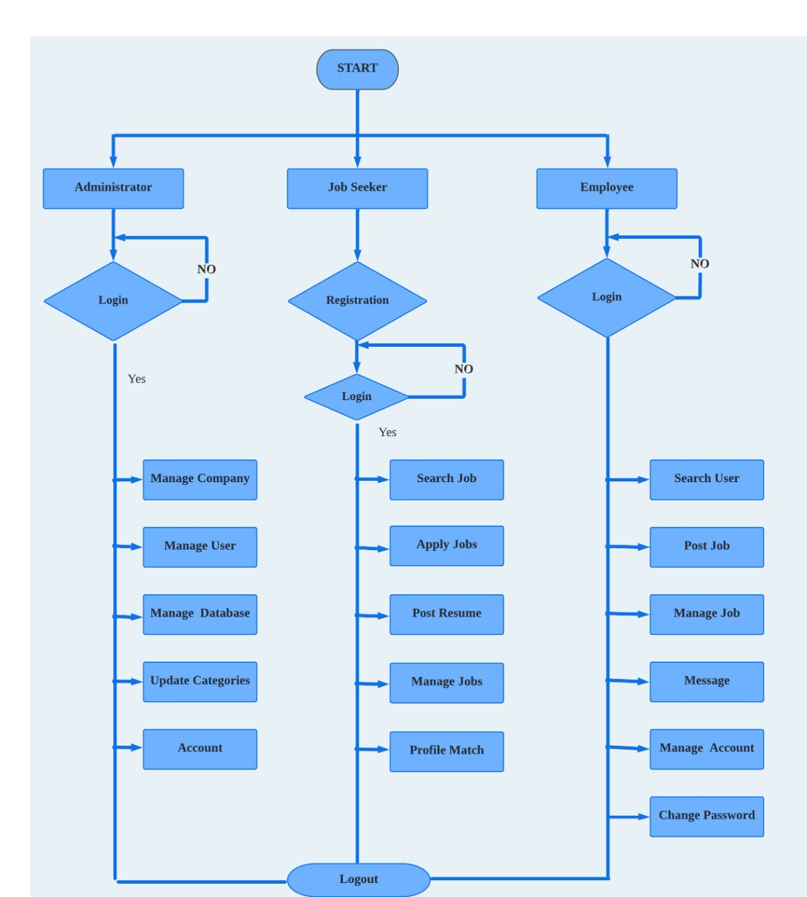
FLOW CHART

Slide 13
DATA FLOW DIAGRAM
DFD is the abbreviation for Data Flow Diagram.
The flow of data of a system or a process is represented by DFD.
ZERO LEVEL DFD DIAGRAM.
FIRST LEVEL DFD DIAGRAM.
SECOND LEVEL DFD DIAGRAM.

Slide 14
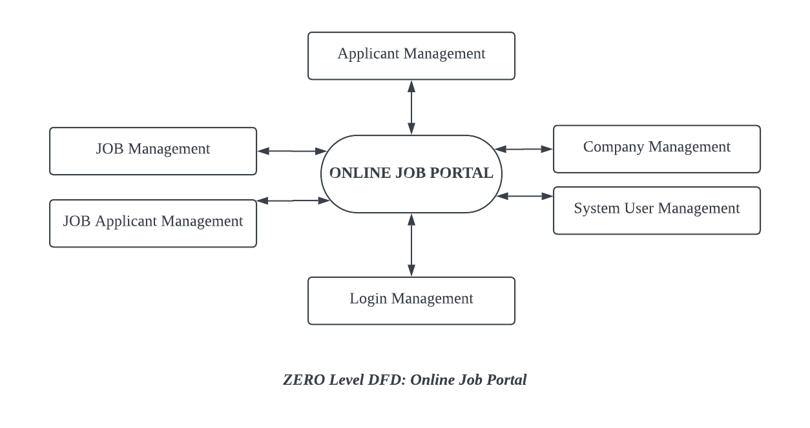
ZERO LEVEL DFD DIAGRAM.

Slide 15
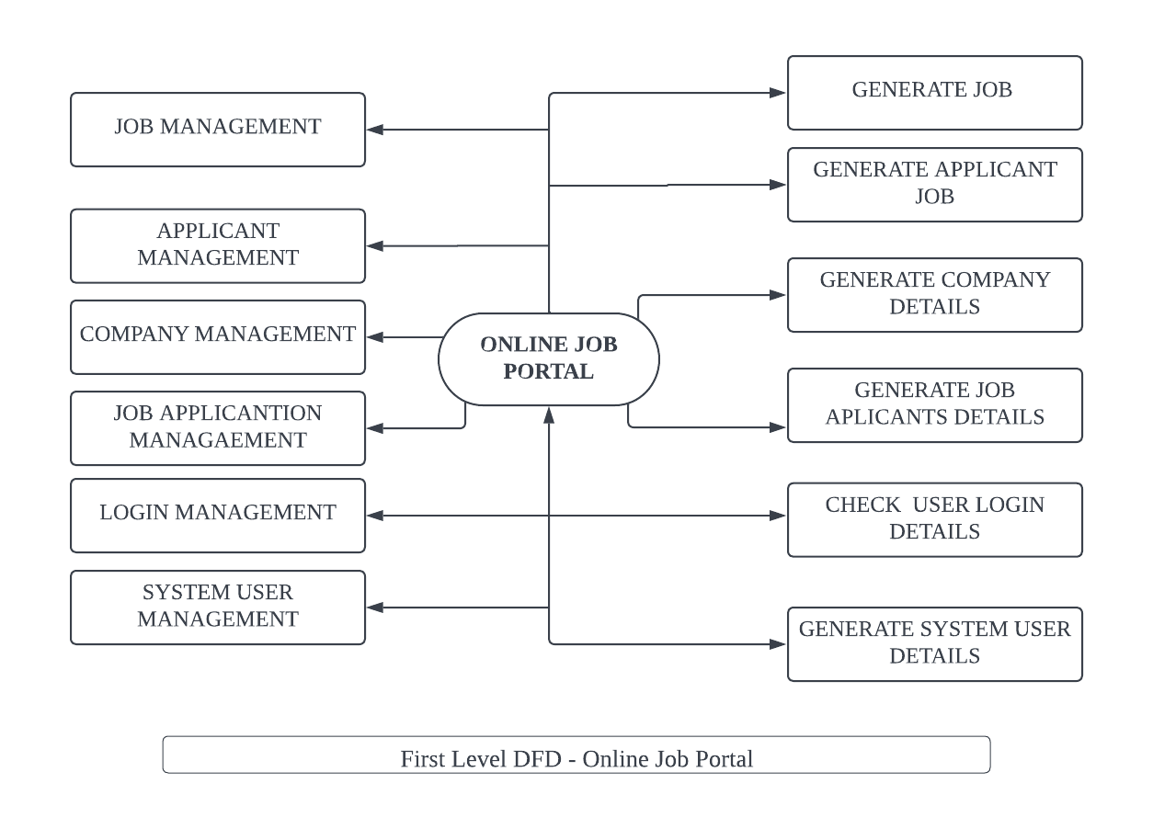
FIRST LEVEL DFD DIAGRAM.

Slide 16
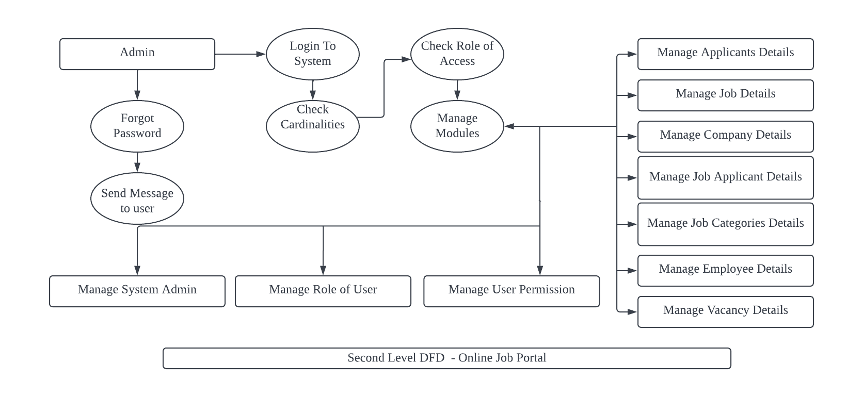
SECOND LEVEL DFD DIAGRAM.

Slide 17
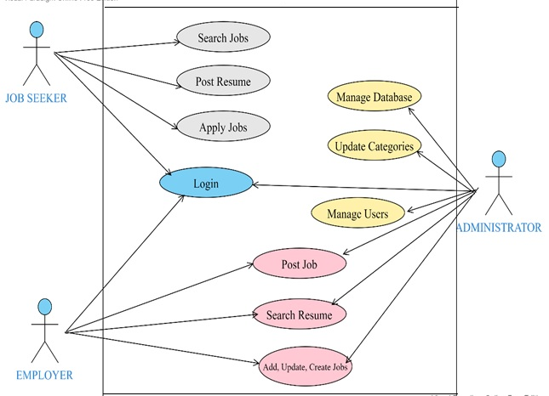
USE CASE DIAGRAM

Slide 18


Slide 19

HOME PAGE

Slide 20
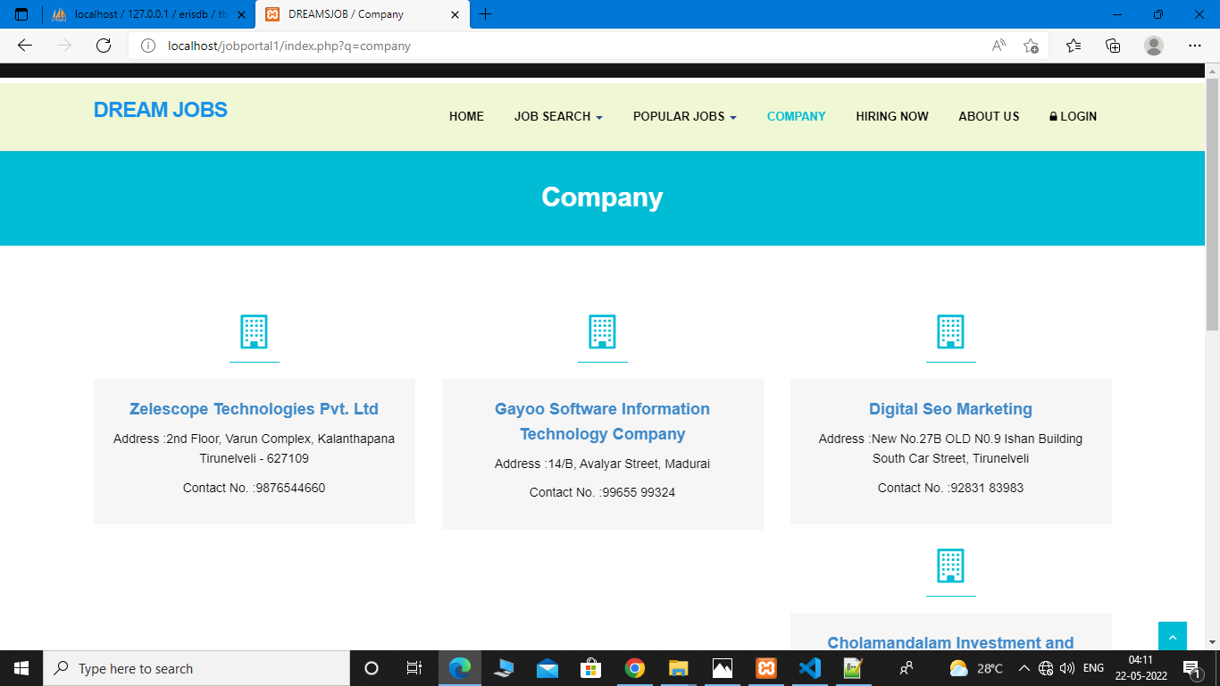
COMPANY

Slide 21
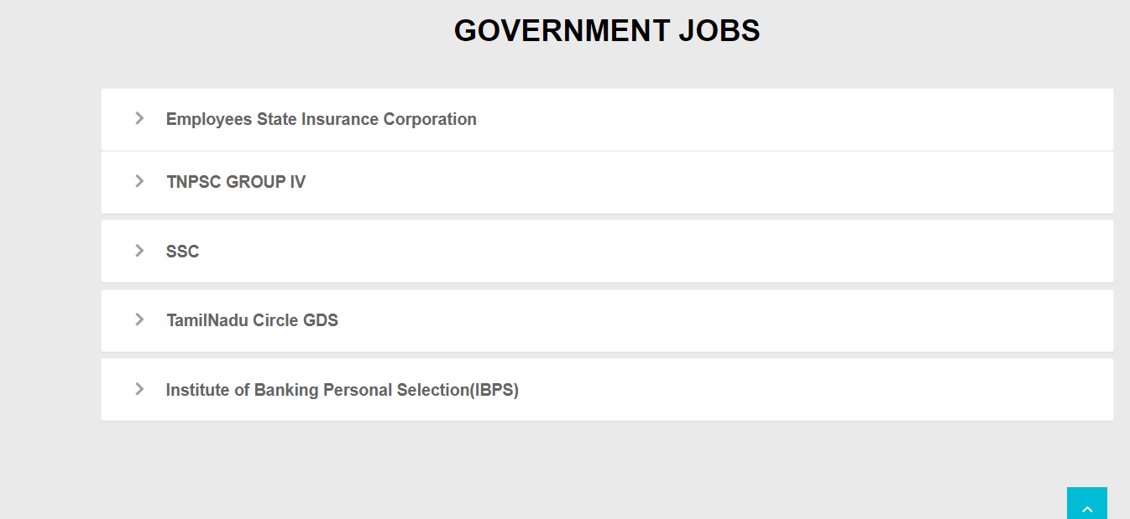
GOVERNMENT JOBS

Slide 22
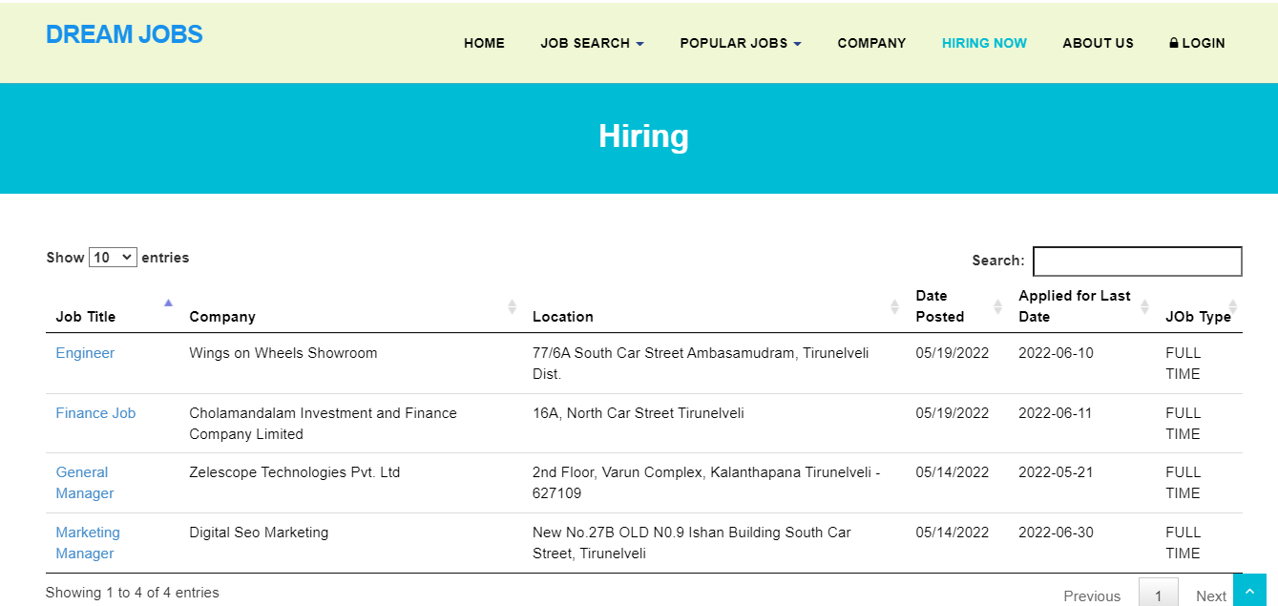
HIRING PAGE

Slide 23
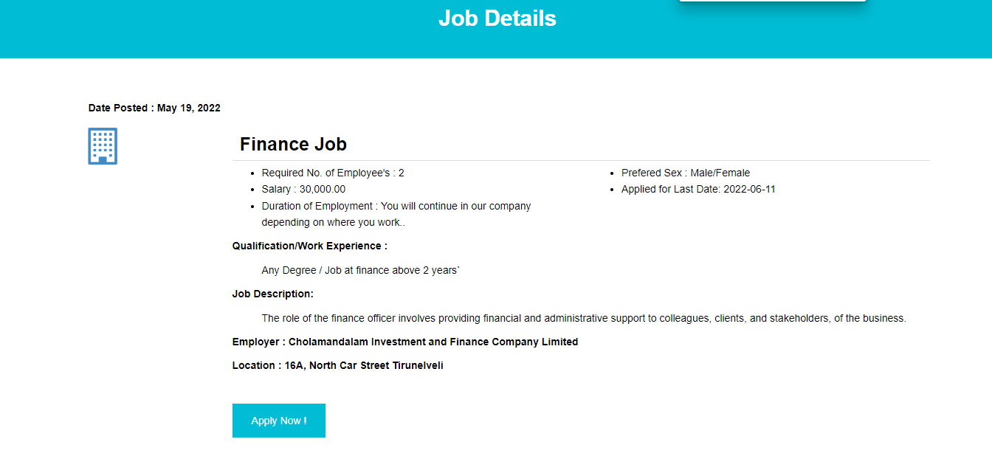
JOB DETAILS

Slide 24
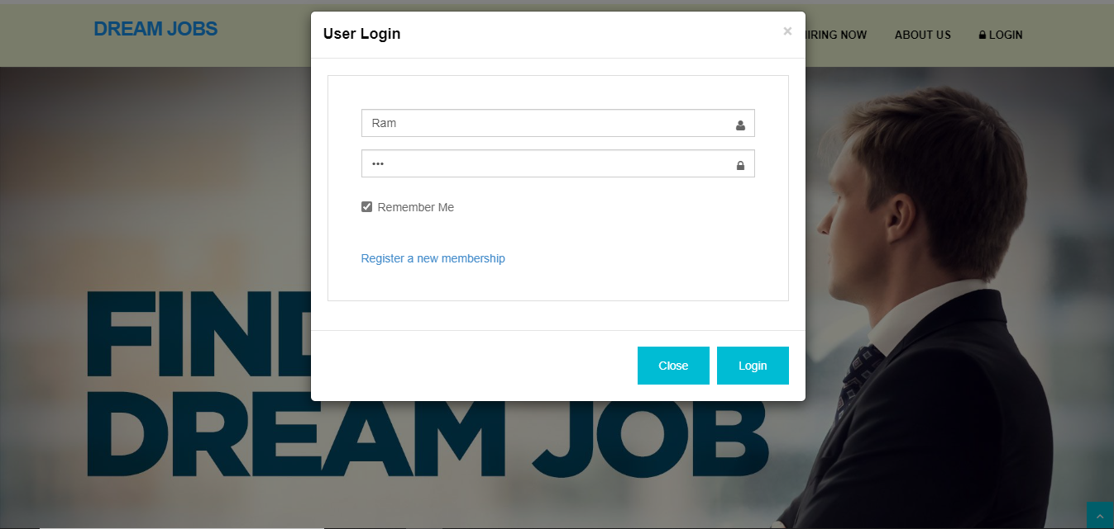

Slide 25
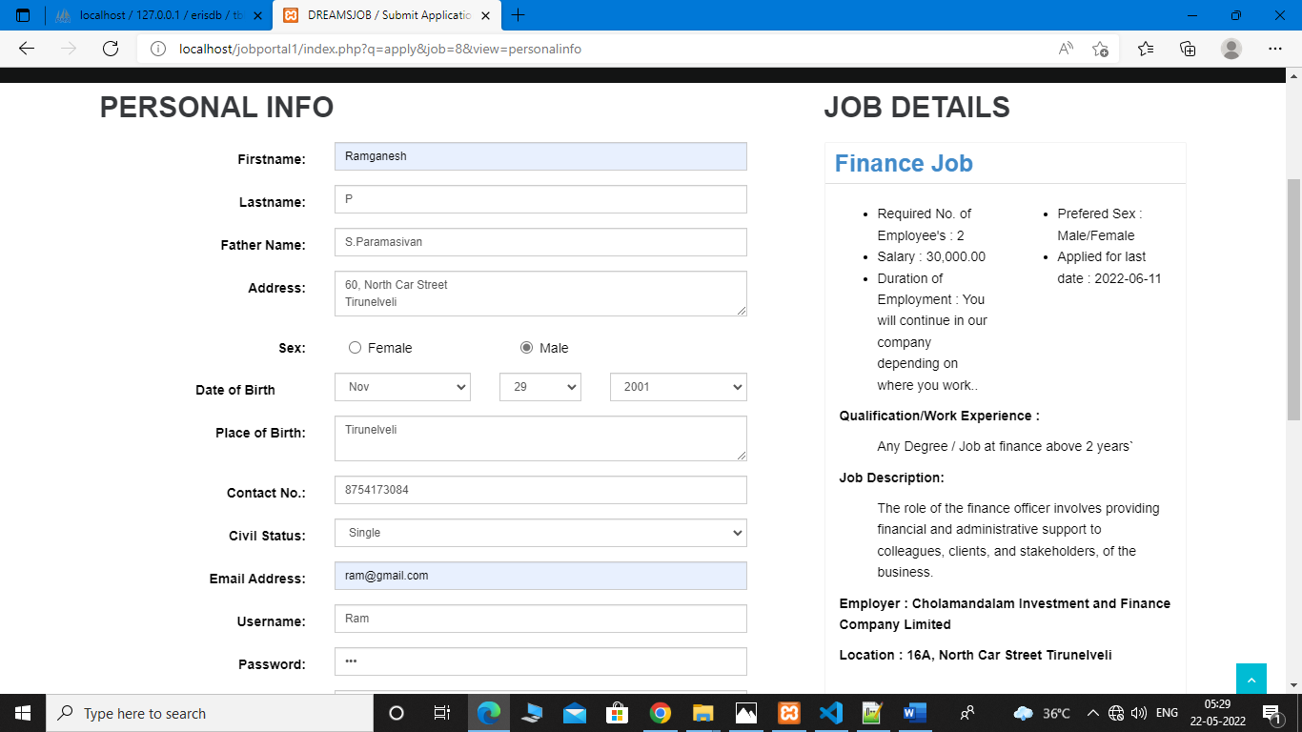
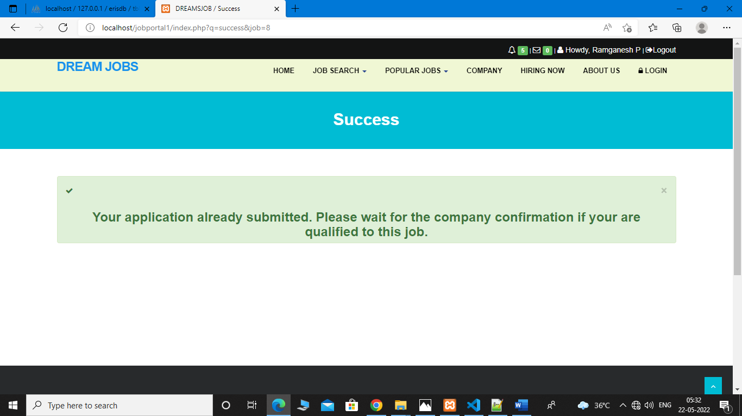

Slide 26
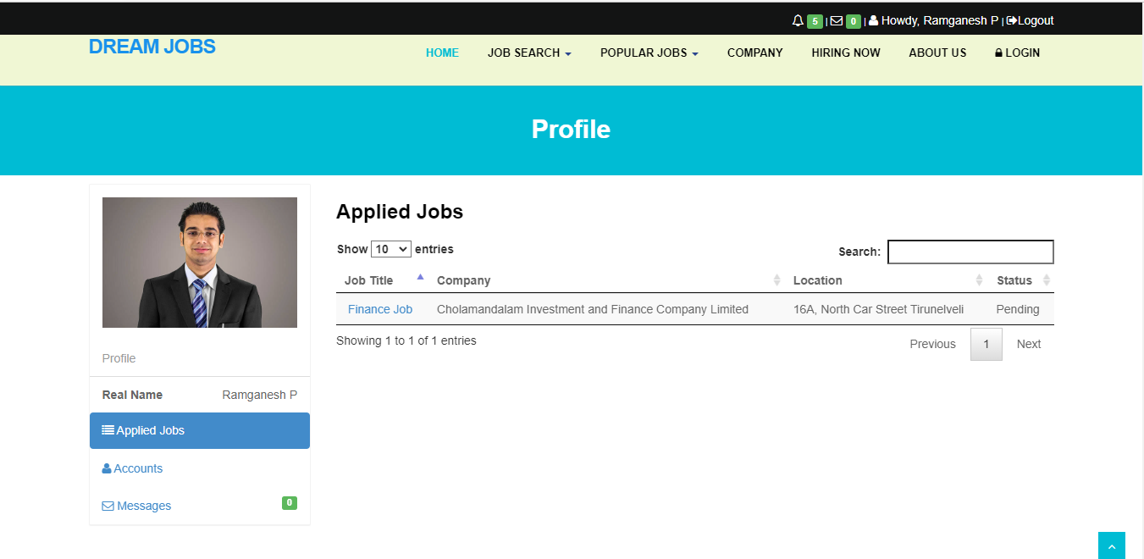

Slide 27
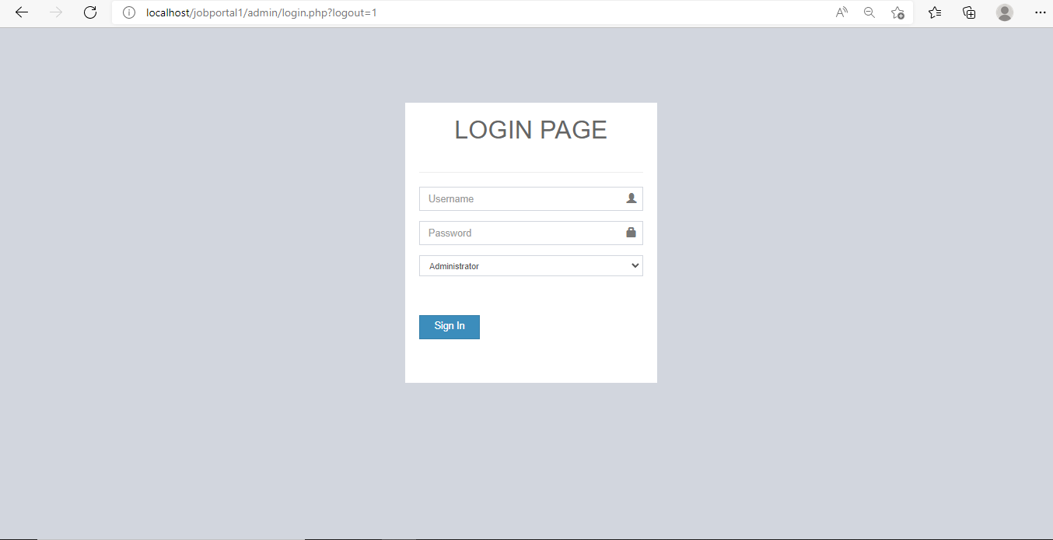

Slide 28
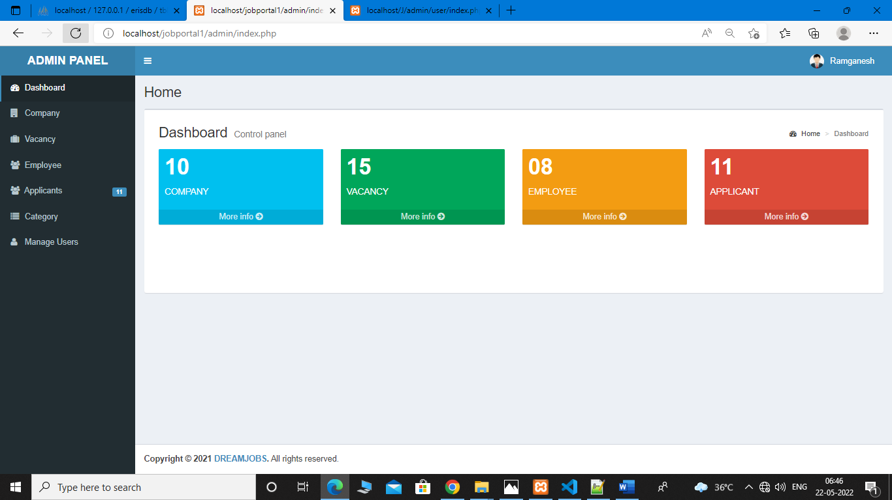

Slide 29
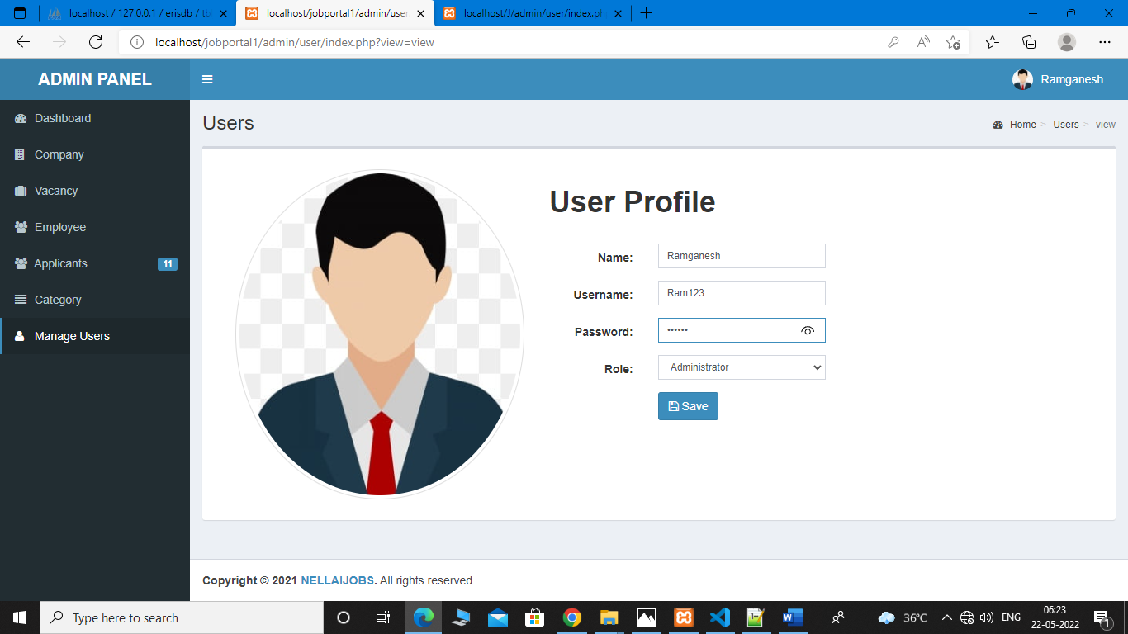

Slide 30
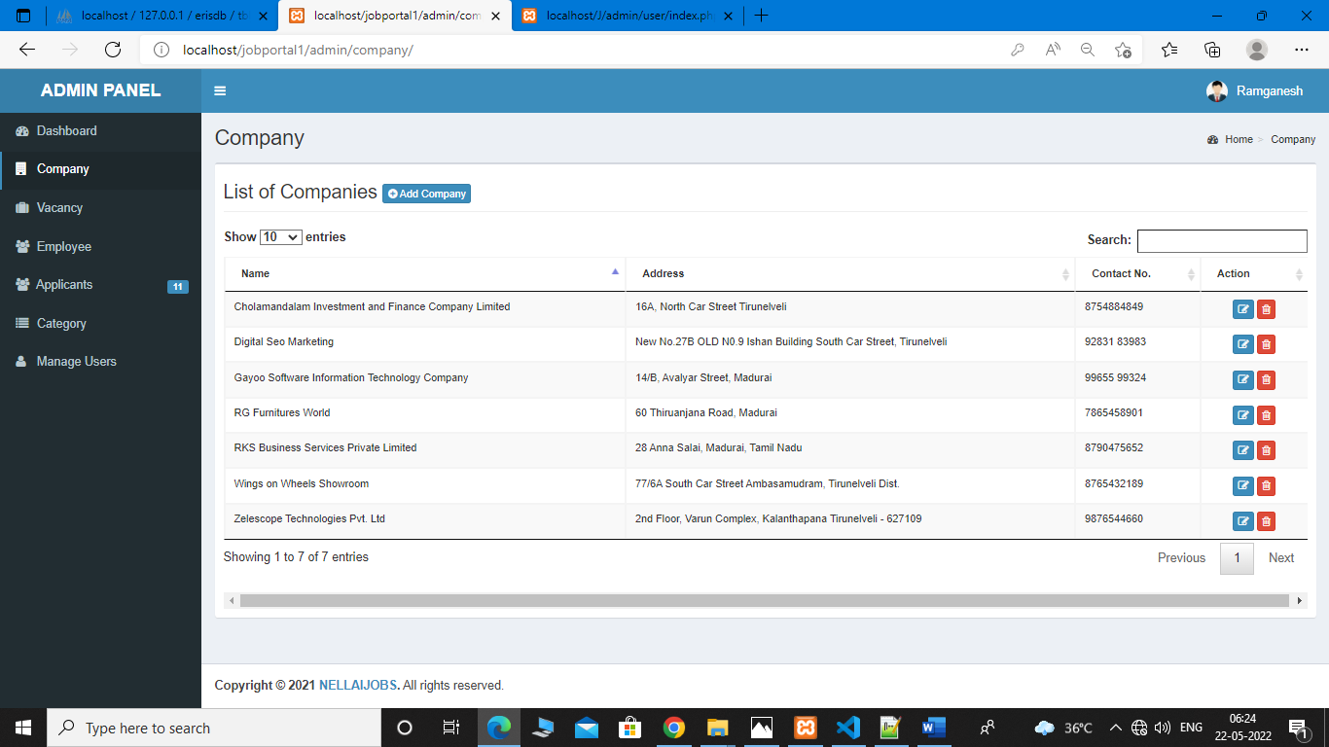

Slide 31
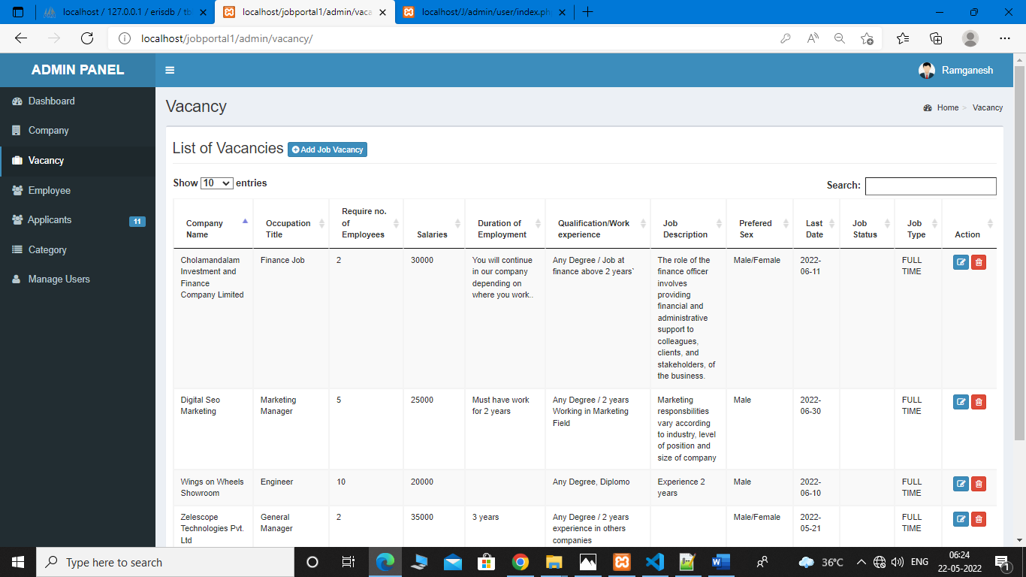

Slide 32
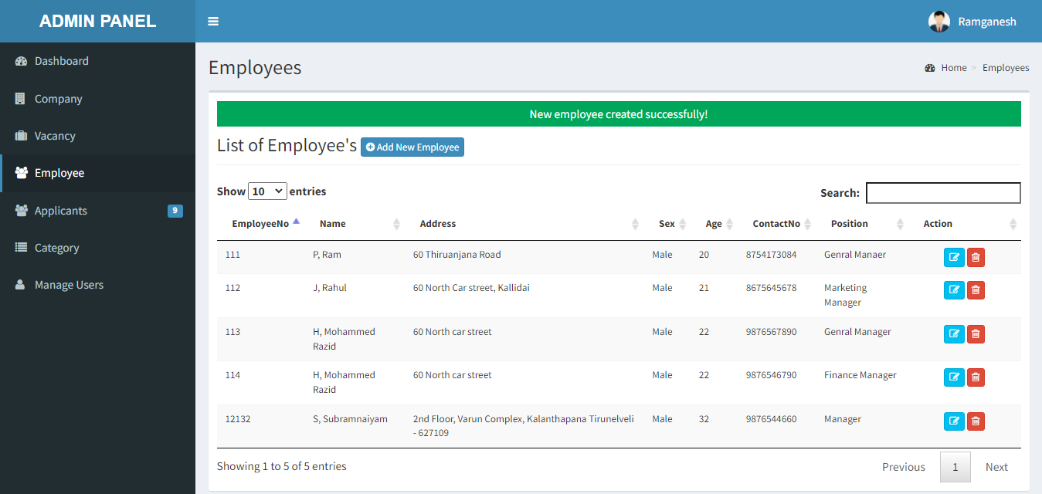

Slide 33
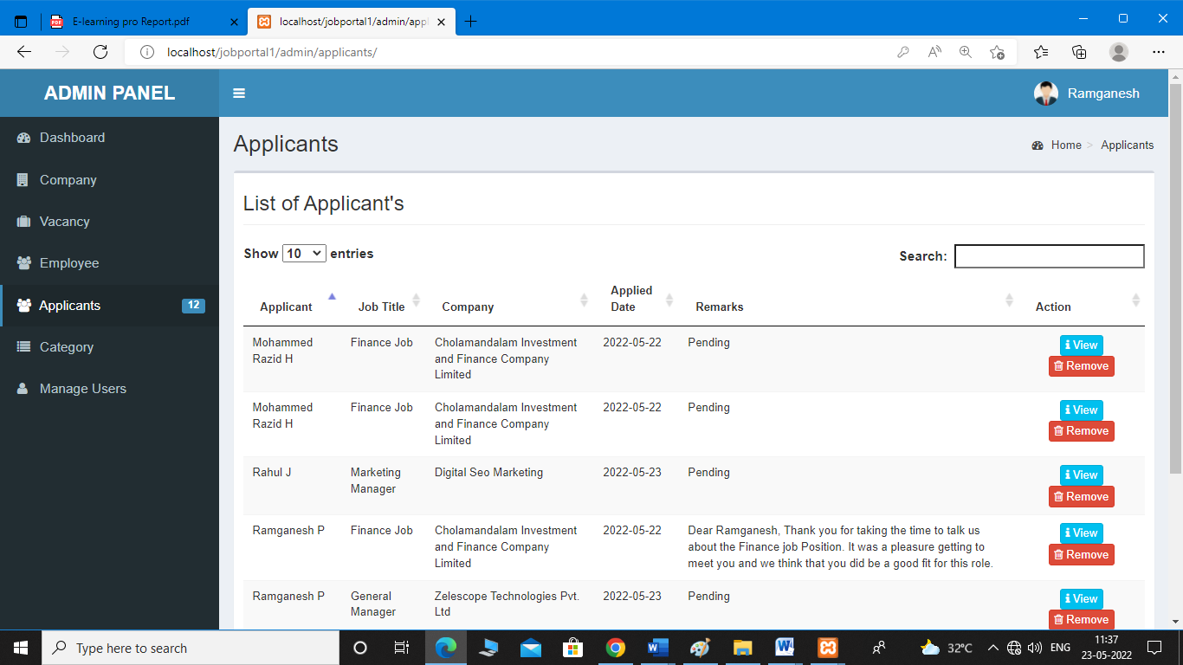

Slide 34
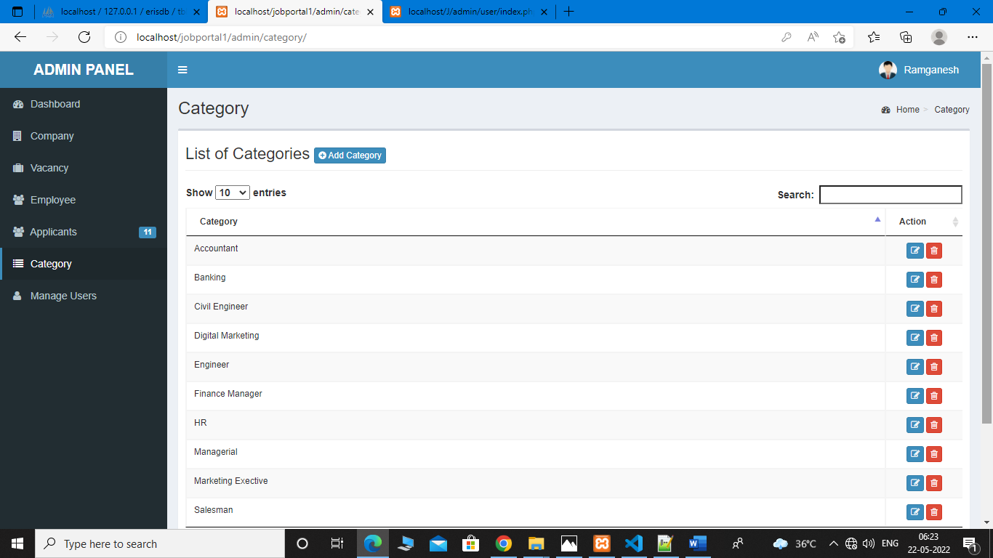

Slide 35
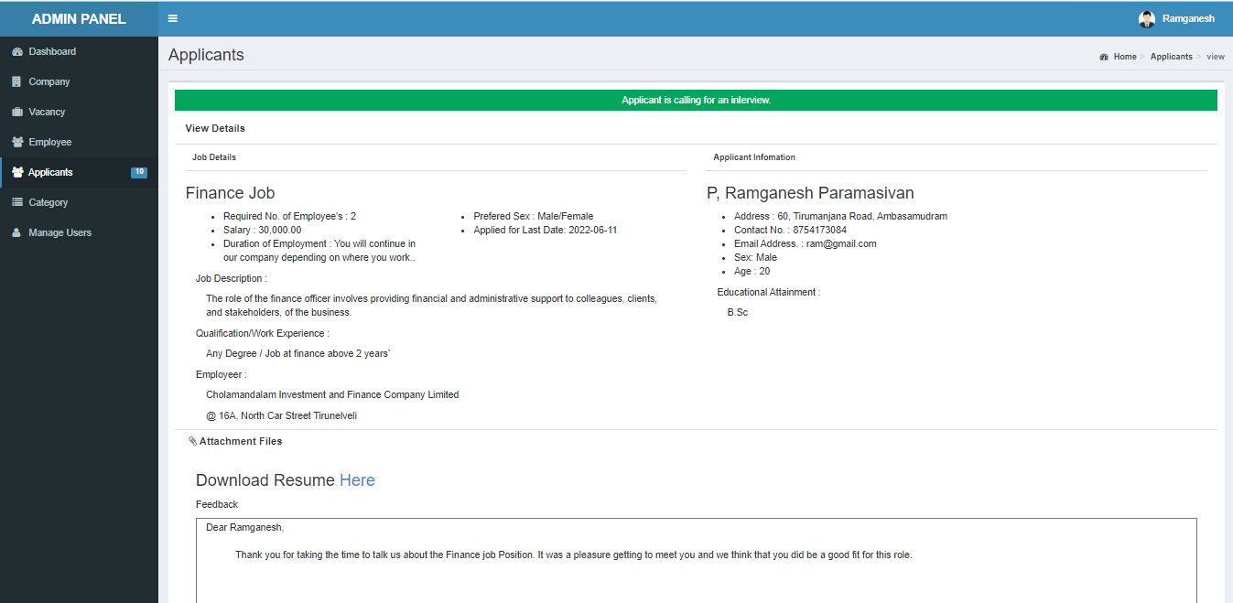

Slide 36
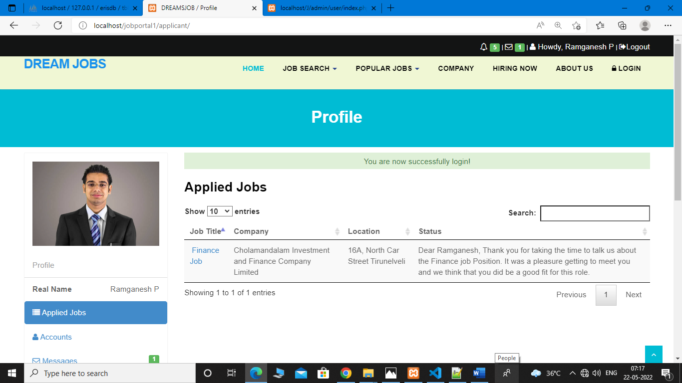

Slide 37
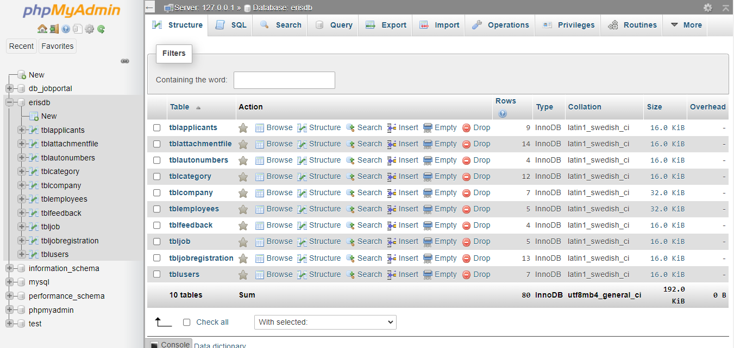
DATABASE DESIGN

Slide 38
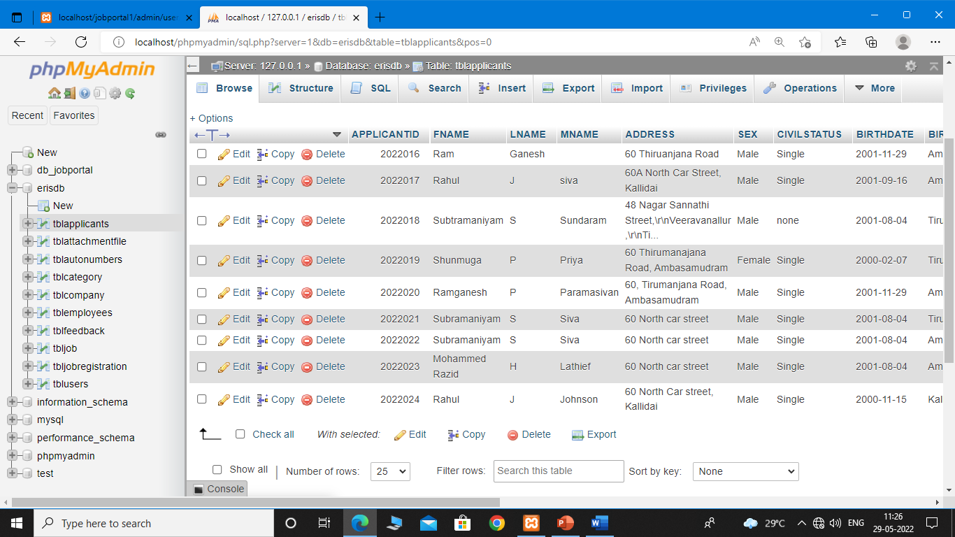
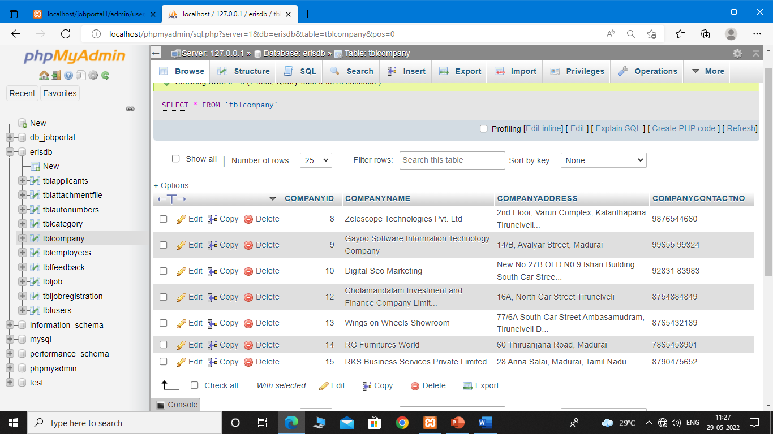

Slide 39
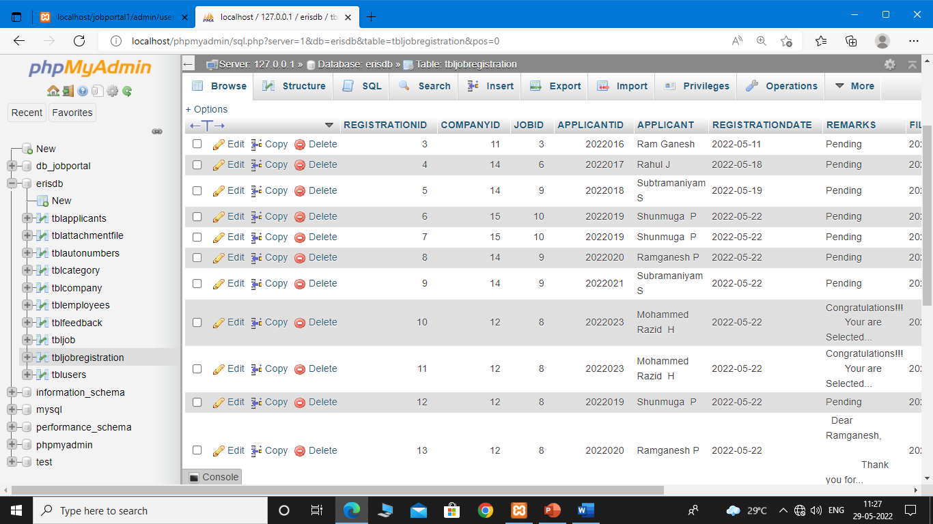
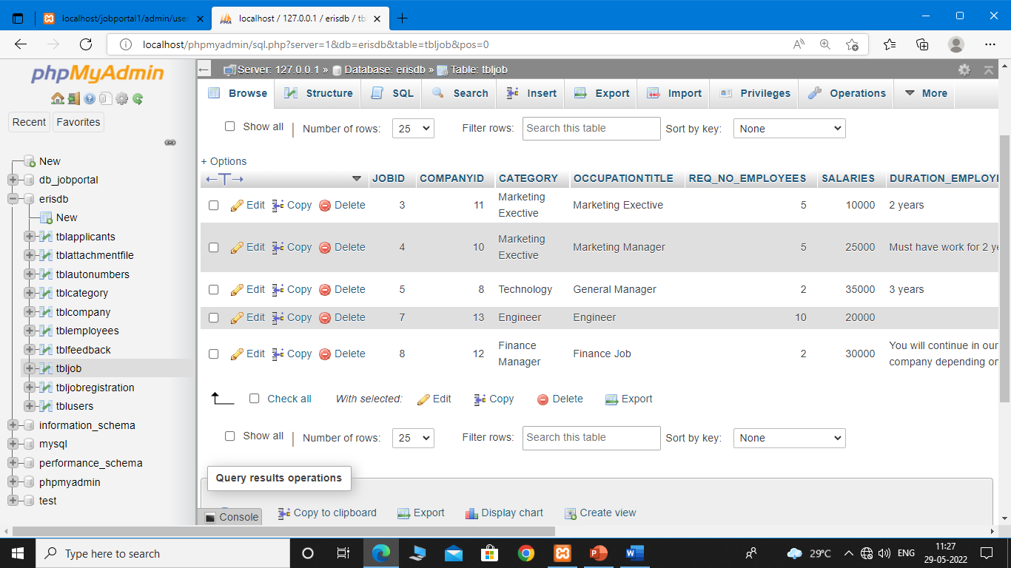

Slide 40
FUTURE ENHANCEMENT
There is sample scope of enhancement and adding functionalities to this application. This application can be extended to send automated interview scheduling through acceptance/rejection of Resume. Companies can delete jobs once the job availably period is over automatically. The application can have a job recommendation system based on the frequent search results of different users. The portal can also send email notifications to candidates about certain job availabilities. There can be a feedback or review section for the application. Also unlike the current job description page, user can view job description in a separate page with one click on the job description. The User functionality can be extended to give the user options to save the job and later apply, to upload multiple documents. The application can be more scalable by extending the search functionality based on country, city or area The user interface can be made more attractive and user friendly.

Slide 41
CONCLUSION
It can be concluded that this project of Online Job Portal was areal learning experience. The principles of software production were well implemented throughout the system. The project has been made as per as the given specifications. The Online Job Portal developed by us is purely based on PHP platform. A Job Portal provides an efficient search online information on Job vacancies for job Seekers. The main goal of this portal is to attempt to produce the right graduates based on the industry needs. However, it is important that be aware the Job Portals can never fulfill all the problems of jobless graduates

Slide 42
THANK YOU

